Slide 1
Revisiting a classic problem in statutory interpretation: Is a minister a laborer?
Tammy Gales, Department of Linguistics, Hofstra University
Lawrence Solan, Brooklyn Law School
Georgia State University
October 18, 2019

Slide 2
Corpus Linguistics used to determine “ordinary meaning” of statutes and “original public meaning” of Constitution
Analyses Mostly Based on Relative Frequency of Competing Interpretations of Individual Words or Phrases, or Words in Proximity to Each Other in order to infer “ordinary meaning”
“Carry a firearm” (on one’s person or in a car) in Muscarello v. United States
Decision 5-4 – “carry” includes transporting in one’s vehicle
Majority Justice Breyer: 1/3 of the instances of “carry” with “gun” collocates are in a car
Dissent Justice Ginsburg: what are the other 2/3?

Slide 3
Criteria for Efficacious Use of Corpus Analysis (Solan and Gales, 2017)
Ordinary usage must be determined to be the legal standard for the case (e.g., Yates v. U.S.)
Must define what makes ordinary meaning ordinary (most frequent usage vs. usage sufficient to imply part of ordinary speech in Muscarello v. U.S)
Must determine appropriate search (e.g., with or without modifiers in People v. Harris)
Must determine whether absence of a meaning from a corpus reflects a linguistic issue or the fact that texts in corpus simply did not discuss certain things (e.g., blue pitta; Bond v. United States with chemical weapons)

Slide 4
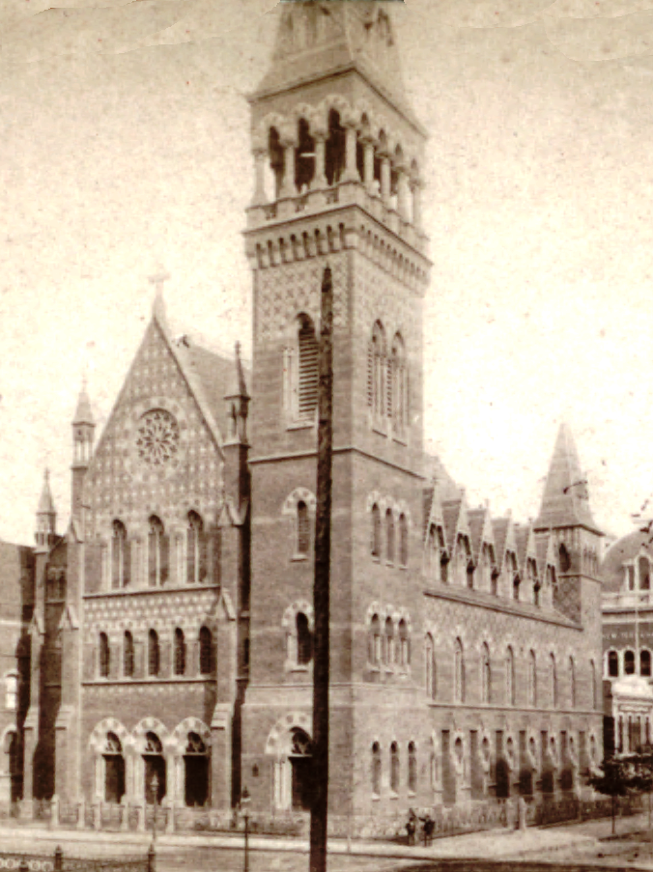
This Project: A Case Study
Building on earlier work, we attempt to use corpus linguistic methods to investigate a case that addresses two concepts: 1) change that may have occurred in language between the statute’s enactment and the case at hand, or between the enactment and the present, and 2) ordinary versus statutory meaning.
Church of the Holy Trinity v. United States (1892)

Slide 5
Alien Contract Labor Law (1885)
…it shall be unlawful for any person, company, partnership, or corporation, in any manner whatsoever, to prepay the transportation, or in any way assist or encourage the importation or migration of any alien or aliens, any foreigner or foreigners, into the United States, … under contract or agreement, … to perform labor or service of any kind in the United States, its Territories, or the District of Columbia.

Slide 6
Section 5: Exemptions
“Skilled labor” of various sorts exempted:
nor shall the provisions of this act apply to professional actors, artists, lecturers or singers, nor to persons employed strictly as personal or domestic servants; provided that nothing in this act shall be construed as prohibiting any individual from assisting any member of his family or any relative or personal friend to migrate from any foreign country to the United States for the purpose of settlement here.

Slide 7
Do the exceptions fit? Not clear.
According to the Oxford Concise Dictionary of the Christian Church, 3rd Ed. (2014), “lecturers”:
“were originally ordained stipendiary ministers (often deacons), appointed in the century after 1559 by town corporations, parishes, and occasionally by individual laymen, to provide regular frequent preaching. …”
Also from Wikipedia:
“In the Church of England, a lecturer is typically a junior or assistant curate serving in a parish. It is a historic title which has fallen out of regular use. Several churches in the UK have clergy identified by the ancient title lecturer, including many London churches, St. Mary's Church, Nottingham and Carlisle Cathedral.”
(Thanks to Bill Eskridge)

Slide 8
US S.Ct. Decision (1892)
The statute does not apply to this case.
Justice Brewer, unanimous
“It is a familiar rule, that a thing may be within the letter of the statute and yet not within the statute, because not within its spirit, nor within the intention of its makers.”
Legislative Intent: to restrict large capitalists in contracting with agents abroad for the shipment of great numbers of an ignorant and servile class of foreign, low-paid laborers, which had the effect of breaking down the U.S. labor market
→ “But it was never suggested that we had a surplus of “brain toilers”, nor that the market for Christian ministers was depressed by foreign competition.”

Slide 9
The Court’s Arguments
Controversial:
Reference to legislative history to argue that the language of the law is subject to broader interpretation than Congress intended
Inferences drawn from the fact that the United States is a Christian nation
Ordinary Meaning:
The common understanding of the terms “labor” and “laborers” does not include “preaching” and “preachers”; and it is to be assumed that words and phrases are used in their ordinary meaning

Slide 10
Corpus Inquiries
United States Statutes at Large (USSL)
835,743 words, 131 statutes, 1789-2008 that use “labor” and “service”
The Corpus of Historical American English (COHA)
400 million words, 1810-2000, fiction, magazines, newspaper articles, and non-fiction
The Corpus of Contemporary American English (COCA)
560 million words, 1990-2017, spoken, fiction, magazines, newspapers, and academic texts
Google Books Ngram Viewer
A search tool used to examine words/phrases in millions of books in the Google collection (both copyrighted and out-of-copyright publications of books, reports, and documents)

Slide 11
Research Queries
1. Construction vs. composition
a. What is the statutory meaning of “labor or service”?
b. What is the ordinary meaning of “labor or service”?
2. “Labor”
a. In ordinary language, what does “labor” mean?
b. In ordinary language, who “labors”?
3. “Clergy”
a. In ordinary language, what do “clergy” do?
b. What does “service” relate to?

Slide 12
1a. “Labor or Service” in Statutory Language
This case presents a problem not addressed by the Court. The term “labor or service” or “service or labor” may not be a matter of ordinary meaning at all, but may be a legal term of art used to describe the work of slaves.
Article 4, section 2, of the Constitution:
No person held to service or labor in one state, under the laws thereof, escaping into another, shall, in consequence of any law or regulation therein, be discharged from such service or labor, but shall be delivered up on claim of the party to whom such service or labor may be due.
The origin of “labor or service” in statutory language was associated with slavery – a concept with extremely negative meaning.

Slide 13
Fugitive Slave Acts of 1793 & 1850
Similarly, the Fugitive Slave Acts contain precisely this expression:
1793
… when a person held to labor in any of the United States, or in either of the Territories on the Northwest or South of the river Ohio, under the laws thereof, shall escape into any other part of the said States or Territory, the person to whom such labor or service may be due, his agent or attorney, is hereby empowered to seize or arrest such fugitive from labor, and to take him or her before any Judge of the Circuit or District Courts of the United States…
1850
And be it further enacted, That when a person held to service or labor in any State or Territory of the United States, has heretofore or shall hereafter escape into another State or Territory of the United States, the person or persons to whom such labor or service may be due ... may pursue and reclaim such fugitive person…

Slide 14
Current Federal Statute barring forced labor
This language continues today (with “service” replaced by “services”) in 18 U.S. Code § 1589. Forced labor:
Whoever knowingly provides or obtains the labor or services of a person by any one of, or by any combination of, the following means--
(1) by means of force, threats of force, physical restraint, or threats of physical restraint to that person or another person;
(2) by means of serious harm or threats of serious harm to that person or another person;
(3) by means of the abuse or threatened abuse of law or legal process; or
(4) by means of any scheme, plan, or pattern intended to cause the person to believe that, if that person did not perform such labor or services, that person or another person would suffer serious harm or physical restraint, shall be punished as provided under subsection (d).

Slide 15
“labor or service” in USSL
With these salient examples in mind, we examined if the phrase was routinely used to refer to the type of manual labor that slaves engaged in, or whether the words typically suggested a broader connotation.
“labor” = 783
“service” = 1903
“labor or service”/“service or labor” = 105 (51 statutes from 1789-2008)
“labour” was also included in each search

Slide 16
Meaning of “labor or service” in Statutes
All primarily manual labor, but a shift over time in application of who labors
1st period (1789-1863): forced manual labor (slaves, indentured servants)
2nd period (1881-1907): forced or low-paid manual labor (indentured, contract, day work)
3rd period (1925-present): voluntary paid manual labor (skilled manual labor employees)

Slide 17
1st Period (1789-1863)
Slaves, indentured servants, or those who perform forced manual labor
1 Stat. 53 (1789): provided always, that any person escaping into the same, from whom labour or service is lawfully claimed in any one of the original States, such fugitive may be lawfully reclaimed, and conveyed to the person claiming his or her labour or service as aforesaid.

Slide 18
2nd Period (1881-1907)
Aliens, foreigners, and contract day laborers who perform forced or temporary low-paid manual labor
34 Stat. 898 (1902): That for every violation of any of the provisions of section four of this Act the persons, partnership, company, or corporation violating the same, by knowingly assisting, encouraging, or soliciting the migration or importation of any contract laborer into the United States shall forfeit and pay for every such offense the sum of one thousand dollars, which may be sued for and recovered by the United States, or by any person who shall first bring his action therefor in his own name and for his own benefit, including any such alien thus promised labor or service of any kind as aforesaid, as debts of like amount are now recovered in the courts of the United States;

Slide 19
3rd Period (1925-present)
Workers or employees who perform voluntary paid manual labor
54 Stat. 348 (1936): Any officer or agent of the United States whose duty it shall be to employ, direct, or control any person employed in connection with the operation or maintenance of such railroad who shall intentionally require or permit such person to be employed for hours of labor or service in violation of this Act shall be deemed guilty of a misdemeanor.

Slide 20
1b. Ordinary Meaning of “labor or service”
Historic “labor or service” (COHA: 1810-2000)
“labor or service” = 14
10 = slaves or the work performed by slaves
1 = the statute in this analysis
3 = paid industrial labor (1873 and 1877) and domestic labor (1954)
GoogleBooks: 1840-1900 were official government documents or historical works referring to such documents:
Contemporary “labor or service” (COCA: 1990-2017)
“labor or service” = 2
2 = workers who held low-paid jobs
GoogleBooks: 1960-2000 non-fiction texts about historical laws, government labor bulletins, and legal documents

Slide 21
Google Books Ngram Viewer “labor or service”

Slide 22
“Labor or Service”: Composition or Construction?
These facts raise an important linguistic question: should the meaning of “labor or service” be taken as compositional (i.e., the sum of their parts) or as a single construction?
Language is largely compositional:
A blue sweater is a sweater that is blue.
But it is also sometime a matter of construction:
“Rough and ready” does not mean that one is both rough and ready.

Slide 23
Additionally… “labor or service of any kind”
If a construction, then this means slave-like work of any kind.
If compositional, it may mean "labor of any kind" or "service of any kind".
→ Difficult to argue that the rector was not performing service of some kind.

Slide 24
Court Opinion
The Court was well aware of these arguments:
It must be conceded that the act of the corporation is within the letter of this section, for the relation of rector to his church is one of service, and implies labor on the one side with compensation on the other. Not only are the general words labor and service both used, but also, as it were to guard against any narrow interpretation and emphasize a breadth of meaning, to them is added “of any kind;” and, further, as noticed by the Circuit Judge in his opinion, the fifth section, which makes specific exceptions, among them professional actors, artists, lecturers, singers and domestic servants, strengthens the idea that every other kind of labor and service was intended to be reached by the first section.
→ Yet, the Court determined that the purpose of the statute, the fact that the title of the statute mentioned only “labor,” and the ordinary meaning of “labor” outmatched the arguments to the contrary.

Slide 25
2a. What does “labor” mean?
Adjs collocating with “LABOR” highlight the physical, manual, or low-paid aspects
KWIC searches produced similar findings for other adjectives
COHA: 1880-1899 | Raw Freq | COCA: 2010-2017 | Raw Freq
Manual | 104 | Manual | 134
Hard | 92 | Hard | 128
Organized | 33 | Cheap | 118
Skilled | 32 | Organized | 101
Productive | 31 | Forced | 96
Unskilled | 25 | Fair | 59
Cheap | 24 | Physical | 46
Arduous | 22 | Skilled | 44
Honest | 21 | Agricultural | 23
Patient | 18 | Environmental | 22

Slide 26
So, what is “labor” in ordinary meaning?
These results demonstrate that while “labor” can be a mental activity (e.g., skilled, patient), it is most often applied to contexts wherein physical or manual labor is occurring.
Results also demonstrated that by the end of the nineteenth century, when the law was enacted and the case arose, “labor” continued to have a connotation of negativity, but its scope had grown to include manual labor that was more than slave-like labor, and, at the margins, more than work that required physical exertion.

Slide 27
2b. Who “labors”?
Two main semantic categories of collocates:
1) working-class, forced, or slave-like workers (e.g., “slave”, “pauper”, “convict”, “agitators”, “child”, “migrant”)
2) collective noun referring to laborers as impersonal mass units (e.g., “class”, “ranks”, “market”, “supply”, “pool”)
COHA: 1880-1899 | Raw Freq | COCA: 2010-2017 | Raw Freq
Classes | 84 | Market | 585
Slave | 23 | Force | 525
Market | 30 | Child | 154
Prison | 19 | Slave | 90
Pauper | 18 | Markets | 81
Ranks | 13 | Farm | 45
Poverty | 13 | Supply | 41
Convict | 11 | Pool | 34
Agitators | 10 | Migrant | 31
Missionary | 10 | Migration | 29

Slide 28
Qualities of those who “labor”
Mostly negative semantic prosody of “laborers” (e.g., “problem”, “expense”, “troubles”, “disputes”, and “imprisonment”).
One term with a positive quality of “laborers” was “dignity”. However, upon further examination, the structure of each sentence carried negative connotations in the context.
1880 (MAG): The words spoken about the dignity of labor are not apt to be very sincere.

Slide 29
So, who “labors” in ordinary meaning?
Aside from one outlier, where “clergy” were “the teachers of religion”:
1835 (MAG): The average salaries paid to the bishops and archbishops exceed twenty-five thousand dollars a year, and some of them receive as much as a hundred thousand dollars; while a numerous class of the clergy, the laboring clergy too, are obliged to content themselves with a scanty subsistence.
“Labor” primarily = physical labor
oftentimes as an impersonal, yet organized, mass, referenced in a negative manner
The few instances that reference clergy juxtapose their work from that of “laborers” in both class and mental effort

Slide 30
3a. What do “clergy” do?
Verbs that collocate with “clergy” to examine actions they perform
Primarily cognitive and communication verbs
COHA: 1880-1899 | Raw Freq | COCA: 2010-2017 | Raw Freq
Opposed | 4 | Founded | 8
Bore | 4 | Estimates | 8
Accepted | 4 | Declared | 6
Attended | 3 | Ordained | 5
Announced | 3 | Marry | 5
Represented | 3 | Denied | 5
Arrogated | 2 | Refused | 5
Denouncing | 2 | Exercised | 4
Strained | 2 | Banned | 4
Deprived | 2 | Blamed | 4

Slide 31
Cognitive & Communicative Verbs
These verbs primarily reflect activities that are linguistically cognitive or communicative in nature.
1887 (NF): …the priesthood accepted, without any effective protest, the fires of the Council of Constance which consumed Huss, and the abominations of the Borgias at Rome.
1898 (NF): The Federalist clergy joined in denouncing Jefferson on the ground that he was an atheist.
2013 (MAG): One ministry declared simply: “Adoption is the new pregnant.” # All of this enthusiasm has created an army of advocates rallying to revive an international adoption business that has been on the wane since 2004, and has reoriented the industry in a more overtly religious direction.

Slide 32
So, what do “clergy” do?
The primary functions of “clergy” are not manual, indentured-like labor, but activities that require more cognitive and communicative duties such as “denouncing”, “declaring”, and “opposing”.

Slide 33
3b. Why not “service”?
The senses of “service” are mixed – activities related to being in servitude and providing helpful service, which could clearly relate to the activities of the “clergy”
1882 (MAG): … it must have been obvious to all the leading members of the church which now had gained him that so great gifts of preaching, such deep theological // learning, so keen a power of analyzing the workings of the human heart, should be available for the service of the priesthood.

Slide 34
So, do “clergy” provide “service”?
Given this research, the outcome of Holy Trinity Church may have been decided differently if the Court had investigated the meaning and use of “service” when collocated with the “work” “clergy” perform.
Yet the phrase “labor or service” as a construction had its own meaning in statutory and ordinary language, and a negative connotation that went beyond the meanings of the individual terms.

Slide 35
Summary of Holy Trinity Church
“Labor or Service” as a single construction was used through most of the 19th century to refer to manual, slave-like labor in statutory and ordinary language and generally carried a negative connotation
Collocates “labor” and “service” provided a progressively broader range of meanings in ordinary language over time of who labors and what labor is
A focus (like the court’s) on “labor” alone revealed that it primarily refers to physical, manual, and low-paid labor, which does not fit the activities that clergy perform, which are more cognitive and communicative in nature
Finally, it appears that “service” is a better fit for the activities performed by “clergy”, despite the fact that the court did not consider this part of the phrase separate from its role in the construction “labor or service.”

Slide 36
Summary of Researching Historical Cases
Thus, it appears that the Court got the ordinary meaning argument correct based on corpus analysis
The statute could apply to the clergy hired under contract by a church, but it would be an outlying use, notwithstanding the fact that the statute includes “labor or service of any kind.”
As for clergy not being listed among the exceptions, the argument may not be as strong as it initially seemed.
The history of usage in statutory and ordinary language do support the Court’s decision.
Here, we have attempted to strengthen the use of corpus linguistic analysis by
relying on doubly dissociated terms, such as “labor” and “clergy”
highlighting the value of creating or consulting specialized and reference corpora
exploring inferences from collocational information in addition to the frequency of words
Our goal has been to demonstrate how corpus analysis can be of help in exploring historical cases, for which introspection about meaning is unavailable.

Slide 37
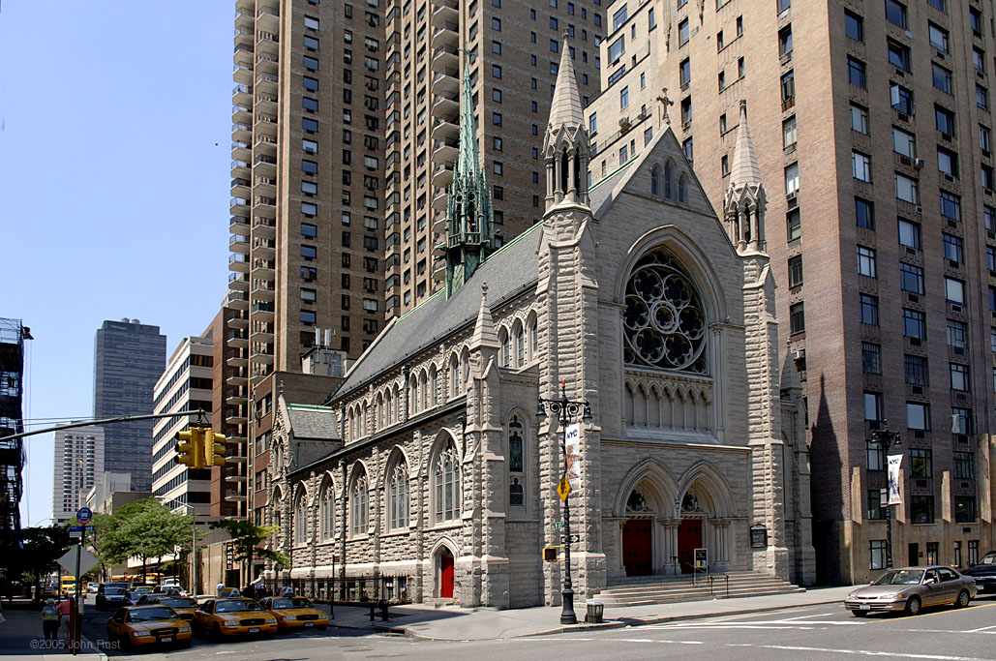
Thank you!
Tammy Gales
Tammy.A.Gales@Hofstra.edu
Lawrence M. Solan
larry.solan@brooklaw.edu

